Slide 1


App Inventor CIS Summer Camp 2017
Notes:
Healthy Plants hand out.

Slide 2




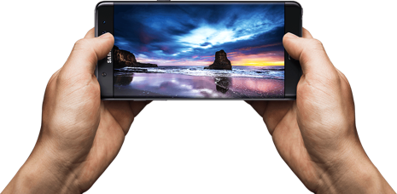
Notes:
Will animate in powerpoint so icons move and grow out of the phone.
(I used the Clicker Hero and Roblox apps instead of facebook and google maps for the 8-10 year olds)

Slide 3
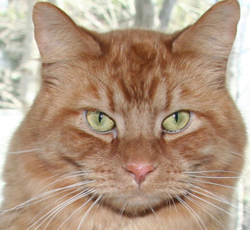
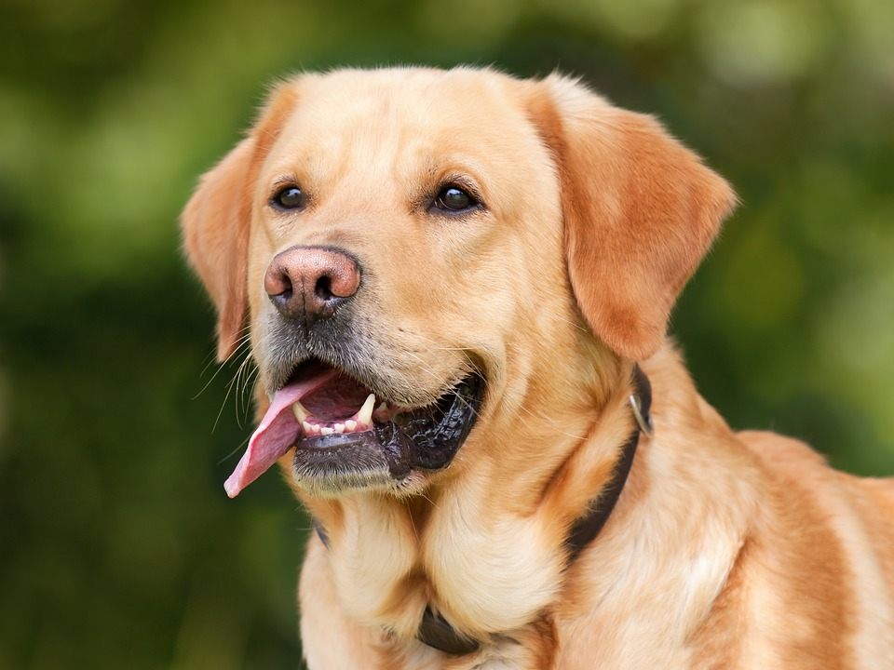
HelloWoofPurr
Notes:
Hello Purr Interlude - use handouts

Slide 4





Notes:
Probably include some video here to show IoT

Slide 5
Healthy Plants
Notes:
Healthy Plants hand out.

Slide 7
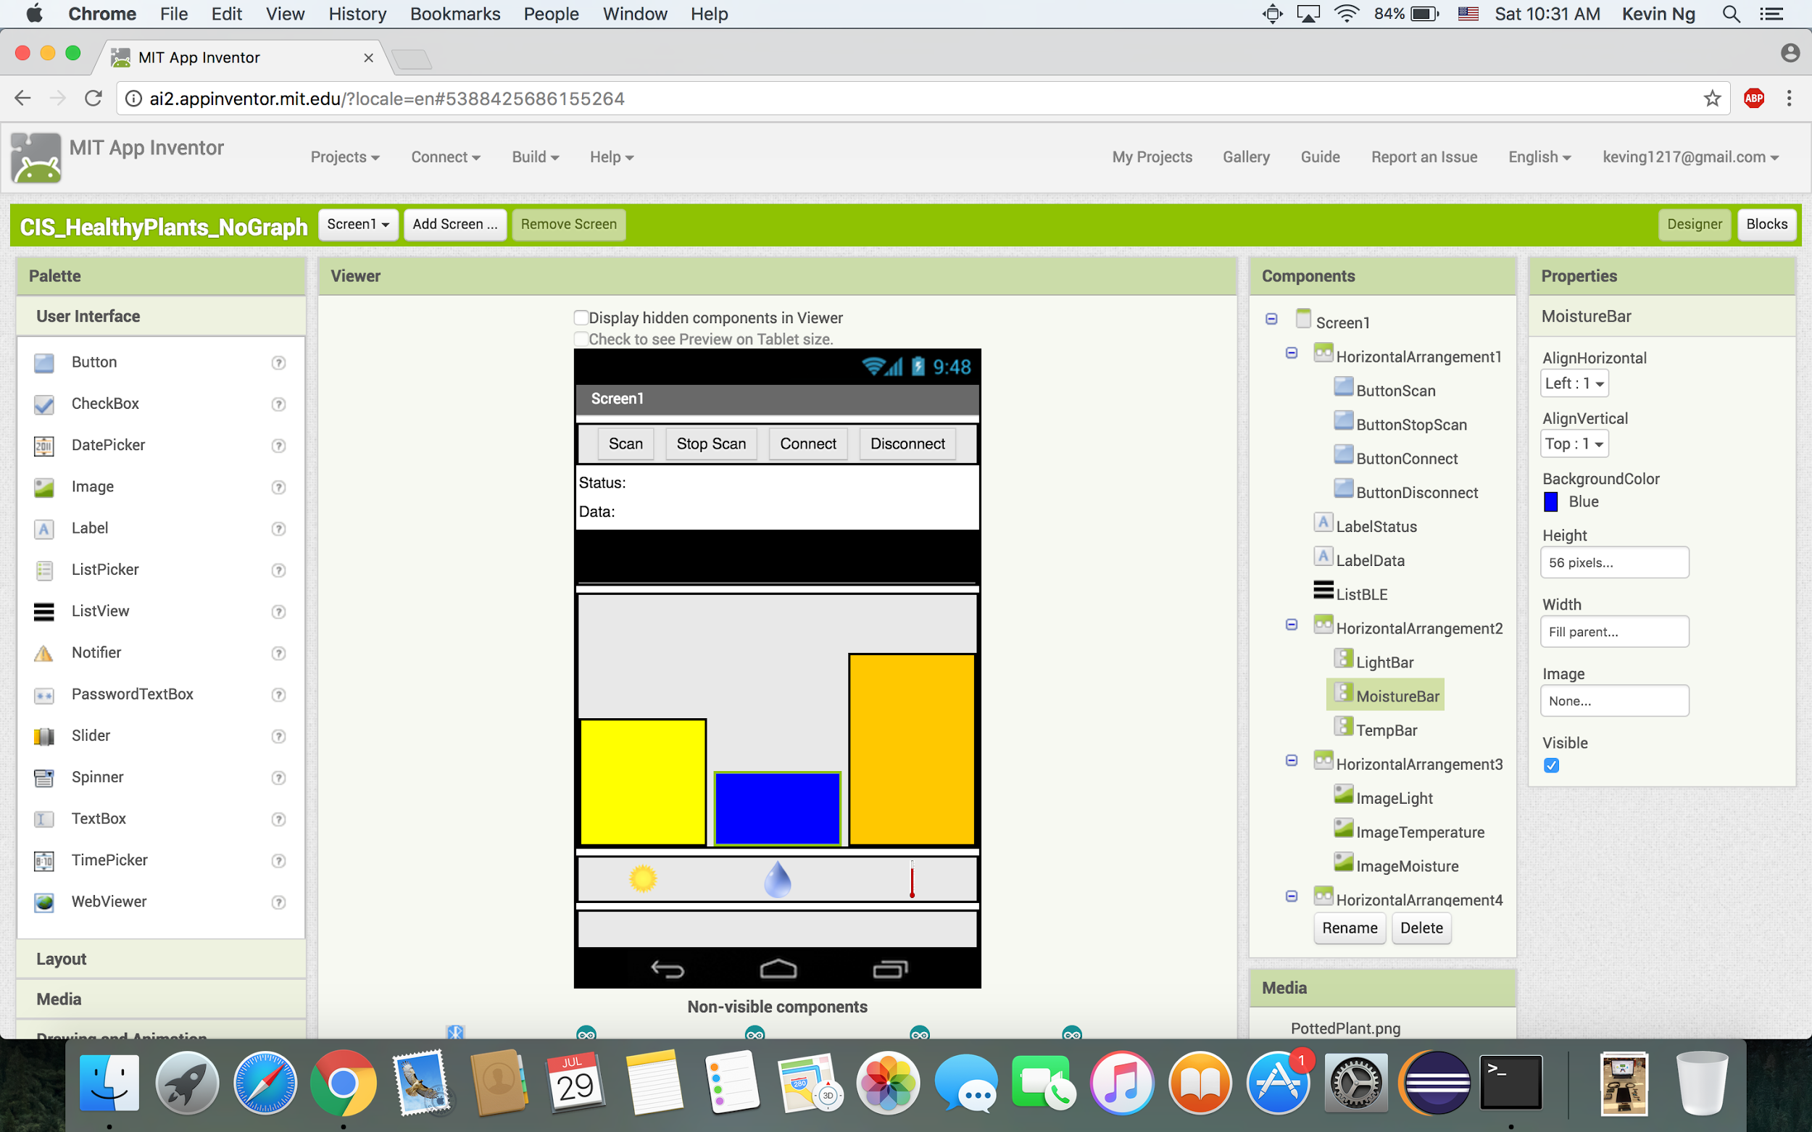

Slide 8
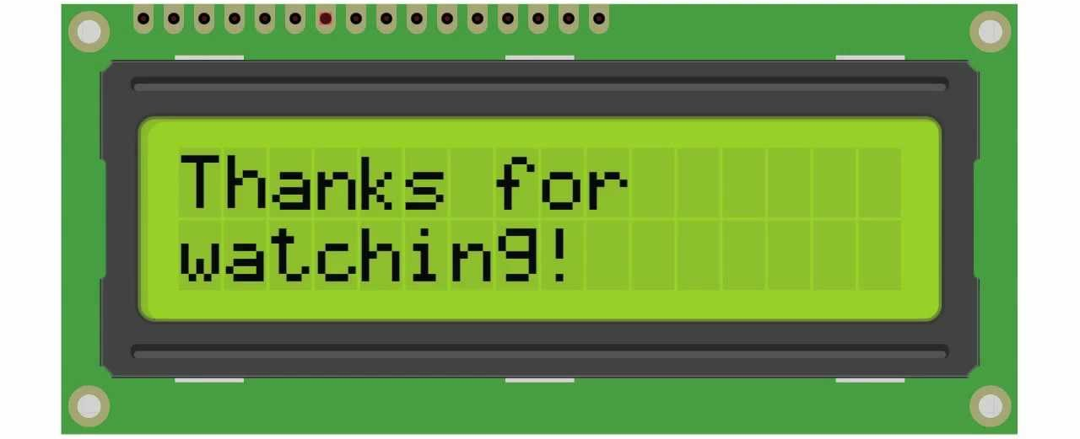


Notes:
Overview of IOT, and how the healthy plant app works, wrap up, and reflection.

